Slide 1
MODULE 4 - POINTERS, STRUCTURES AND UNION
CSA4101 PROBLEM SOLVING USING C
I Year CSE B

Slide 2
MODULE 4 - POINTERS, STRUCTURES AND UNION (6L+6P)
Pointers – Dynamic Memory allocation – Structure and Union – Files.
Practical Component:
(i) Program to compute sum of integers stored in a 1-D array using pointers and
dynamic memory allocation
(ii) Program to read and print records of a student/payroll database using structures
(iii) Program to simulate file copy
(iv) Program to illustrate sequential access file
(v) Program to illustrate random access file
MODULE 2 - FUNDAMENTALS OF C

Slide 3
4.1 Introduction to Pointers
A Pointer in C language is a variable which holds the address of another variable of same data type.
Pointers are used to access memory and manipulate the address.
Pointers are one of the most distinct and exciting features of C language.
It provides power and flexibility to the language.
MODULE 2 - FUNDAMENTALS OF C

Slide 4
4.1 Introduction to Pointers
Address in C
Whenever a variable is defined in C language, a memory location is assigned for it, in which it's value will be stored.
We can easily check this memory address, using the & symbol.
If var is the name of the variable, then &var will give it's address.
#include<stdio.h>
void main()
{
int var = 7;
printf("Value of the variable var is: %d\n", var);
printf("Memory address of the variable var is: %x\n", &var);
}
Output
Value of the variable var is: 7
Memory address of the variable var is: fff4
MODULE 2 - FUNDAMENTALS OF C

Slide 5
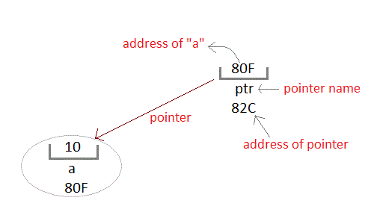
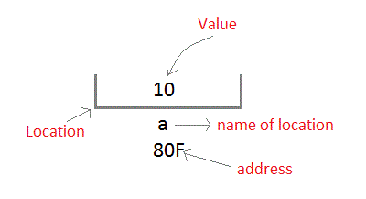
4.1 Introduction to Pointers
Since the memory addresses are also just numbers, they can also be assigned to some other variable.
The variables which are used to hold memory addresses are called Pointer variables.
A pointer variable is therefore nothing but a variable which holds an address of some other variable.
And the value of a pointer variable gets stored in another memory location.
MODULE 2 - FUNDAMENTALS OF C

Slide 6
4.1.1 Benefits of using pointers
Pointers are more efficient in handling Arrays and Structures.
Pointers allow references to function and thereby helps in passing of function as arguments to other functions.
It reduces length of the program and its execution time as well.
It allows C language to support Dynamic Memory management.
MODULE 2 - FUNDAMENTALS OF C

Slide 7
4.1.2 Declaring, Initializing and using a pointer variable
Declaration of Pointer variable
Data type of a pointer must be same as the data type of the variable to which the pointer variable is pointing.
Initialization of Pointer variable
Pointer Initialization is the process of assigning address of a variable to a pointer variable. Pointer variable can only contain address of a variable of the same data type.
datatype *pointer_name;
#include<stdio.h>
void main()
{
int a = 10;
int *ptr; //pointer declaration
ptr = &a; //pointer initialization
}
#include<stdio.h>
void main()
{
float a;
int *ptr;
ptr = &a; // ERROR, type mismatch
}
MODULE 2 - FUNDAMENTALS OF C

Slide 8
4.1.2 Example
#include <stdio.h>
void main()
{
int a, *p; // declaring the variable and pointer
a = 10;
p = &a; // initializing the pointer
printf("%d", *p); //this will print the value of 'a'
printf("%d", *&a); //this will also print the value of 'a'
printf("%u", &a); //this will print the address of 'a'
printf("%u", p); //this will also print the address of 'a'
printf("%u", &p); //this will print the address of 'p’
getch();
}
MODULE 2 - FUNDAMENTALS OF C

Slide 9
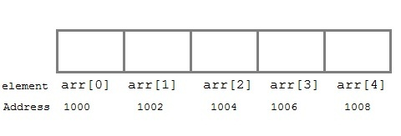
4.1.3 Pointer and Arrays
When an array is declared, compiler allocates sufficient amount of memory to contain all the elements of the array.
Ex: int arr[5] = { 1, 2, 3, 4, 5 };
Assuming that the base address of arr is 1000 and each integer requires two bytes, the five elements will be stored as follows:
arr is equal to &arr[0] by default
int *p;
p = arr;
// or,
p = &arr[0];
//both the statements are equivalent.
MODULE 2 - FUNDAMENTALS OF C

Slide 10
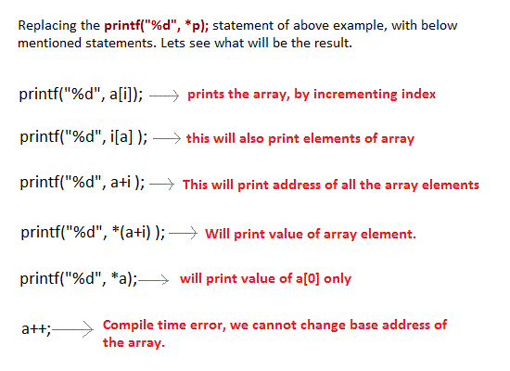
4.1.3 Pointer and Arrays
#include <stdio.h>
int main()
{
int i;
int a[5] = {1, 2, 3, 4, 5};
int *p = a; // same as int*p = &a[0]
for (i = 0; i < 5; i++)
{
printf("%d", *p);
p++;
}
return 0;
}
MODULE 2 - FUNDAMENTALS OF C

Slide 11
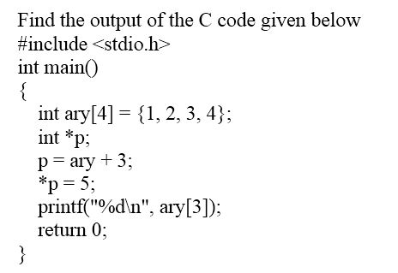
4.1.3 Example
5
MODULE 2 - FUNDAMENTALS OF C

Slide 12
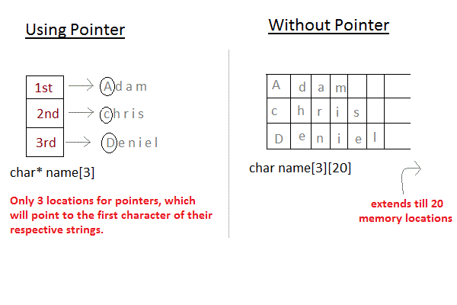
4.1.4 Array of Pointers
char *name[3] = {
"Adam",
"chris",
"Deniel"
};
//Now lets see same array without using pointer
char name[3][20] = {
"Adam",
"chris",
"Deniel"
};
In the second approach memory wastage is more, hence it is prefered to use pointer in such cases.
MODULE 2 - FUNDAMENTALS OF C

Slide 13
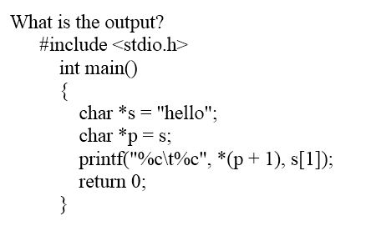

4.1.4 Array of Pointers
MODULE 2 - FUNDAMENTALS OF C

Slide 14
4.2 Dynamic Memory Allocation in C
The process of allocating memory at runtime is known as dynamic memory allocation.
Library routines known as memory management functions are used for allocating and freeing memory during execution of a program.
These functions are defined in stdlib.h header file.
Function | Use of Function
malloc() | Allocates requested size of bytes and returns a pointer first byte of allocated space
calloc() | Allocates space for an array elements, initializes to zero and then returns a pointer to memory
free() | deallocate the previously allocated space
realloc() | Change the size of previously allocated space
MODULE 2 - FUNDAMENTALS OF C

Slide 15
4.2 Dynamic Memory Allocation in C
Function | Syntax
malloc () | malloc (number *sizeof(int));
calloc () | calloc (number, sizeof(int));
realloc () | realloc (pointer_name, number * sizeof(int));
free () | free (pointer_name);
MODULE 2 - FUNDAMENTALS OF C

Slide 16
4.2.1 example 1
#include <stdio.h>
#include <stdlib.h>
int main()
{
int num, i, *ptr, sum = 0;
printf("Enter number of elements: ");
scanf("%d", &num);
ptr = (int*) malloc(num * sizeof(int)); //memory allocated using malloc
if(ptr == NULL)
{
printf("Error! memory not allocated.");
exit(0);
}
printf("Enter elements of array: ");
for(i = 0; i < num; ++i)
{
scanf("%d", ptr + i);
sum += *(ptr + i);
}
printf("Sum = %d", sum);
free(ptr);
return 0;
}
MODULE 2 - FUNDAMENTALS OF C

Slide 17
4.2.1 example 2
#include <stdio.h>
#include <stdlib.h>
int main() // using calloc()
{
int num, i, *ptr, sum = 0;
printf("Enter number of elements: ");
scanf("%d", &num);
ptr = (int*) calloc(num, sizeof(int));
if(ptr == NULL)
{
printf("Error! memory not allocated.");
exit(0);
}
printf("Enter elements of array: ");
for(i = 0; i < num; ++i)
{
scanf("%d", ptr + i);
sum += *(ptr + i);
}
printf("Sum = %d", sum);
free(ptr);
return 0;
}
MODULE 2 - FUNDAMENTALS OF C

Slide 18
4.2.1 example 1
DIFFERENCE BETWEEN STATIC MEMORY ALLOCATION AND DYNAMIC MEMORY ALLOCATION IN C:
Static memory allocation | Dynamic memory allocation
In static memory allocation, memory is allocated while writing the C program. Actually, user requested memory will be allocated at compile time. | In dynamic memory allocation, memory is allocated while executing the program. That means at run time.
Memory size can’t be modified while execution. Example: array | Memory size can be modified while execution. Example: Linked list
MODULE 2 - FUNDAMENTALS OF C

Slide 19
4.2.1 example 1
DIFFERENCE BETWEEN MALLOC() AND CALLOC() FUNCTIONS IN C:
malloc() | calloc()
It allocates only single block of requested memory | It allocates multiple blocks of requested memory
int *ptr;ptr = malloc( 20 * sizeof(int) );For the above, 20*4 bytes of memory only allocated in one block. Total = 80 bytes | int *ptr;Ptr = calloc( 20, 20 * sizeof(int) );For the above, 20 blocks of memory will be created and each contains 20*4 bytes of memory. Total = 1600 bytes
malloc () doesn’t initializes the allocated memory. It contains garbage values | calloc () initializes the allocated memory to zero
type cast must be done since this function returns void pointer int *ptr;ptr = (int*)malloc(sizeof(int)*20 ); | Same as malloc () function int *ptr;ptr = (int*)calloc( 20, 20 * sizeof(int) );
MODULE 2 - FUNDAMENTALS OF C

Slide 20
4.3 Structure
Structure is a collection of variables of different types under a single name.
For example: You want to store some information about a person: his/her name, Employee ID number and salary. You can easily create different variables name (char), EID(int), salary( float) to store these information separately.
This collection of all related information under a single name Person is a structure.
MODULE 2 - FUNDAMENTALS OF C

Slide 21
4.3 Structure
Structure Definition in C
Keyword struct is used for creating a structure.
Syntax of structure
struct structure_name
{
data_type member1;
data_type member2;
.
.
data_type memeber;
};
Note: Don't forget the semicolon }; in the ending line.
We can create the structure for a staff as mentioned above as:
struct staff
{
char name[50];
int EID;
float salary;
};
MODULE 2 - FUNDAMENTALS OF C

Slide 22
4.3.1 Structure variable declaration
When a structure is defined, it creates a user-defined type but, no storage or memory is allocated.
struct staff
{
char name[50];
int EID;
float salary;
};
int main()
{
struct staff person1, person2, person3[20];
return 0;
}
struct staff
{
char name[50];
int EID;
float salary;
} person1, person2, person3[20];
In both cases, two variables person1, person2 and an array person3 having 20 elements of type struct staff are created.
MODULE 2 - FUNDAMENTALS OF C

Slide 23
4.3.1 Structure variable declaration
There are two types of operators used for accessing members of a structure.
Member operator(.)
Structure pointer operator(->)
Any member of a structure can be accessed as:
structure_variable_name.member_name
Suppose, we want to access salary for variable person2. Then, it can be accessed as:
person2.salary
MODULE 2 - FUNDAMENTALS OF C

Slide 24
4.3.2 Structures within structures
Structures can be nested within other structures in C programming.
struct complex
{
int imag_value;
float real_value;
} comp;
struct number
{
struct complex comp;
int real;
} num1, num2;
Suppose, you want to access imag_value for num2 structure variable then, following structure member is used.
num2.comp.imag_value
MODULE 2 - FUNDAMENTALS OF C

Slide 25
4.3.2 Structures Example
printf("\n Enter marks: ");
scanf("%d %d",&s[i].mark1, &s[i].mark2);
printf("\n");
}
printf("Displaying Information:\n\n");
// displaying information
printf("Roll number\t Name\t Mark1\t Mark2\t Average\n");
for(i=0; i<4; ++i)
{
s[i].avg=(s[i].mark1+s[i].mark2)/2;
printf("\n%d\t\t%s\t%d\t%d\t%.2f",i+1, s[i].name,s[i].mark1,s[i].mark2,s[i].avg);
}
getch();
return 0;
}
#include <stdio.h>
struct student
{
char name[50];
int roll,mark1,mark2;
float avg;
};
struct student s[10];
int main()
{
int i;
clrscr();
printf("Enter information of students:\n");
for(i=0; i<4; ++i) // storing information
{
s[i].roll = i+1;
printf("For roll number%d,\n",s[i].roll);
printf("Enter name: ");
scanf("%s", s[i].name);
//gets(s[i].name);
MODULE 2 - FUNDAMENTALS OF C

Slide 26
4.3.3 Passing structures to a function
There are mainly two ways to pass structures to a function:
Passing by value
Passing by reference
MODULE 2 - FUNDAMENTALS OF C

Slide 27
4.3.4 Structure and Pointer
Structures can be created and accessed using pointers.
A pointer variable of a structure can be created as below:
struct name {
member1;
member2;
.
.
};
int main()
{
struct name *ptr;
}
MODULE 2 - FUNDAMENTALS OF C

Slide 28
4.3.4 Structure and Pointer
Structures can be created and accessed using pointers.
A pointer variable of a structure can be created as below:
struct name {
member1;
member2;
.
.
};
int main()
{
struct name *ptr;
}
MODULE 2 - FUNDAMENTALS OF C

Slide 29
4.3.4 Structure and Pointer
Accessing structure's member through pointer
A structure's member can be accessed through pointer in two ways:
Referencing pointer to another address to access memory
Using dynamic memory allocation
MODULE 2 - FUNDAMENTALS OF C

Slide 30
4.3.4 1. Referencing pointer to another address to access the memory
#include <stdio.h>
typedef struct person
{
int age;
float weight;
};
int main()
{
struct person *personPtr, person1;
personPtr = &person1;
printf("Enter integer: ");
scanf("%d",&(*personPtr).age);
printf("Enter number: ");
scanf("%f",&(*personPtr).weight);
printf("Displaying: ");
printf("%d%f",(*personPtr).age,(*personPtr).weight);
return 0;
}
Using -> operator to access structure pointer member
(*personPtr).age is same as personPtr->age
(*personPtr).weight is same as personPtr->weight
MODULE 2 - FUNDAMENTALS OF C

Slide 31
4.3.4 2. Using dynamic memory allocation
#include <stdio.h>
#include <stdlib.h>
struct person {
int age;
float weight;
char name[30];
};
int main()
{
struct person *ptr;
int i, num;
printf("Enter number of persons: ");
scanf("%d", &num);
ptr = (struct person*) malloc(num * sizeof(struct person));
for(i = 0; i < num; ++i)
{
printf("Enter name, age and weight of the person respectively:\n");
scanf("%s%d%f", &(ptr+i)->name, &(ptr+i)->age, &(ptr+i)->weight);
}
printf("Displaying Infromation:\n");
for(i = 0; i < num; ++i)
printf("%s\t%d\t%.2f\n", (ptr+i)->name, (ptr+i)->age, (ptr+i)->weight);
return 0;
}
MODULE 2 - FUNDAMENTALS OF C

Slide 32
4.4 C Programming Unions
Unions are quite similar to structures in C.
Like structures, unions are also derived types.
Defining a union is as easy as replacing the keyword struct with the keyword union.
Syntax for UNION
union car
{
char name[50];
int price;
};
union car
{
char name[50];
int price;
} car1, car2, *car3;
union variables car1, car2
union pointer variable car3 of type union car.
MODULE 2 - FUNDAMENTALS OF C

Slide 33
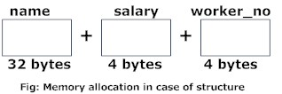
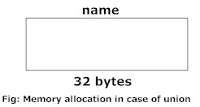
4.4.1 Difference between union and structure
int main()
{
printf("size of union = %d", sizeof(uJob));
printf("\nsize of structure = %d", sizeof(sJob));
return 0;
}
#include <stdio.h>
union unionJob
{
//defining a union
char name[32];
float salary;
int workerNo;
} uJob;
struct structJob
{
char name[32];
float salary;
int workerNo;
} sJob;
Output
size of union = 32
size of structure = 40
MODULE 2 - FUNDAMENTALS OF C

Slide 34
4.4.1 Difference between union and structure
The amount of memory required to store a structure variable is the sum of memory size of all members.
But, the memory required to store a union variable is the memory required for the largest element of an union.
In the case of structure, all of its members can be accessed at any time.
But, in the case of union, only one of its members can be accessed at a time and all other members will contain garbage values.
MODULE 2 - FUNDAMENTALS OF C

Slide 35
4.5 C Programming Files I/O
Types of Files
Text files
  Text files are the normal .txt files that you can easily create using Notepad or any simple text editors.
  When you open those files, you'll see all the contents within the file as plain text. You can easily edit or delete the contents
Binary files
  Binary files are mostly the .bin files in your computer.
  Instead of storing data in plain text, they store it in the binary form (0's and 1's).
  They can hold higher amount of data, are not readable easily and provides a better security than text files.
MODULE 2 - FUNDAMENTALS OF C

Slide 36
4.5 C Programming Files I/O
File Operations
In C, you can perform four major operations on the file, either text or binary:
Creating a new file
Opening an existing file
Closing a file
Reading from and writing information to a file
MODULE 2 - FUNDAMENTALS OF C

Slide 37
4.5 C Programming Files I/O
The syntax for opening a file in standard I/O is:
ptr = fopen("fileopen","mode")
For Example:
fopen("E:\\cprogram\\newprogram.txt","w");
fopen("E:\\cprogram\\oldprogram.bin","rb");
Closing a File
The file (both text and binary) should be closed after reading/writing.
Closing a file is performed using library function fclose().
fclose(fptr);
MODULE 2 - FUNDAMENTALS OF C

Slide 38
4.5 C Programming Files I/O
File Mode | Meaning of Mode | During Inexistence of file
r | Open for reading. | If the file does not exist, fopen() returns NULL.
rb | Open for reading in binary mode. | If the file does not exist, fopen() returns NULL.
w | Open for writing. | If the file exists, its contents are overwritten. If the file does not exist, it will be created.
wb | Open for writing in binary mode. | If the file exists, its contents are overwritten. If the file does not exist, it will be created.
a | Open for append. i.e, Data is added to end of file. | If the file does not exists, it will be created.
ab | Open for append in binary mode. i.e, Data is added to end of file. | If the file does not exists, it will be created.
r+ | Open for both reading and writing. | If the file does not exist, fopen() returns NULL.
rb+ | Open for both reading and writing in binary mode. | If the file does not exist, fopen() returns NULL.
w+ | Open for both reading and writing. | If the file exists, its contents are overwritten. If the file does not exist, it will be created.
wb+ | Open for both reading and writing in binary mode. | If the file exists, its contents are overwritten. If the file does not exist, it will be created.
a+ | Open for both reading and appending. | If the file does not exists, it will be created.
ab+ | Open for both reading and appending in binary mode. | If the file does not exists, it will be created.
MODULE 2 - FUNDAMENTALS OF C

Slide 39
4.6 Difference Between Stack & Heap Memory
Stack | Heap
Stack is a memory region where “local variables”, “return addresses of function calls” and “arguments to functions” are hold while C program is executed. | Heap is a memory region which is used by dynamic memory allocation functions at run time.
CPU’s current state is saved in stack memory | Linked list is an example which uses heap memory.
MODULE 2 - FUNDAMENTALS OF C

Slide 40
4.7 File Handling Examples
fgets() – To read a file | Declaration: char *fgets(char *string, int n, FILE *fp) fgets function is used to read a file line by line. In a C program, we use fgets function as below. fgets (buffer, size, fp); where, buffer – buffer to put the data in. size – size of the buffer fp – file pointer
fprintf() – To write into a file | Declaration: int fprintf(FILE *fp, const char *format, …); fprintf() function writes string into a file pointed by fp. In a C program, we write string into a file as below. fprintf (fp, “some data”); or fprintf (fp, “text %d”, variable_name);
MODULE 2 - FUNDAMENTALS OF C

Slide 41
4.7 File Handling Examples
fgetc () | fgetc () function reads a character from file.
fputc () | fputc () functions write a character to file.
MODULE 2 - FUNDAMENTALS OF C

Slide 42
4.7 File Handling Examples
# include <stdio.h>
# include <string.h>
int main( )
{
FILE *fp ;
char data[50];
// opening an existing file
printf( "Opening the file test.c in write mode" ) ;
fp = fopen("test.c", "w") ;
if ( fp == NULL )
{
printf( "Could not open file test.c" ) ;
return 1;
}
printf( "\n Enter some text from keyboard” \
“ to write in the file test.c" ) ;
// getting input from user
while ( strlen ( gets( data ) ) > 0 )
{
// writing in the file
fputs(data, fp) ;
fputs("\n", fp) ;
}
// closing the file
printf("Closing the file test.c") ;
fclose(fp) ;
return 0;
}
MODULE 2 - FUNDAMENTALS OF C

Slide 43
4.7 File Handling Examples
# include <stdio.h>
int main( )
{
FILE *fp ;
char data[50] ;
printf( "Opening the file test.c in read mode" ) ;
fp = fopen( "test.c", "r" ) ;
if ( fp == NULL )
{
printf( "Could not open file test.c" ) ;
return 1;
}
printf( "Reading the file test.c" ) ;
while( fgets ( data, 50, fp ) != NULL )
printf( "%s" , data ) ;
printf("Closing the file test.c") ;
fclose(fp) ;
return 0;
}
MODULE 2 - FUNDAMENTALS OF C

